Slide 1

Does solar energy reduce climate change? How does it help provide more energy efficiency solutions to the country? (United States vs India)
Group 3 Duolingo
Group Members:
Cheong Yie Shen Hewitt (103516128)
Tiong Qi Xuan (103542576)
Time and Day of Regular Meeting:
Monday 9pm-11pm
Tuesday 2pm-4pm

Slide 2
Questions
What have you done on the Project so far?
What you plan to complete before the next stand-up?
What obstacles you are facing in completing your deliverables?

Slide 3
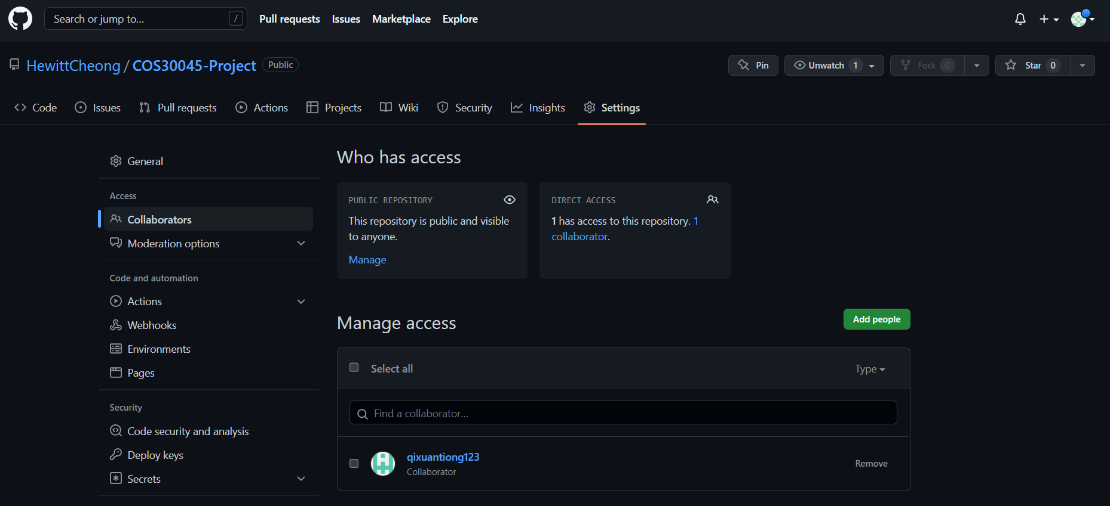
Github Repository

Slide 4
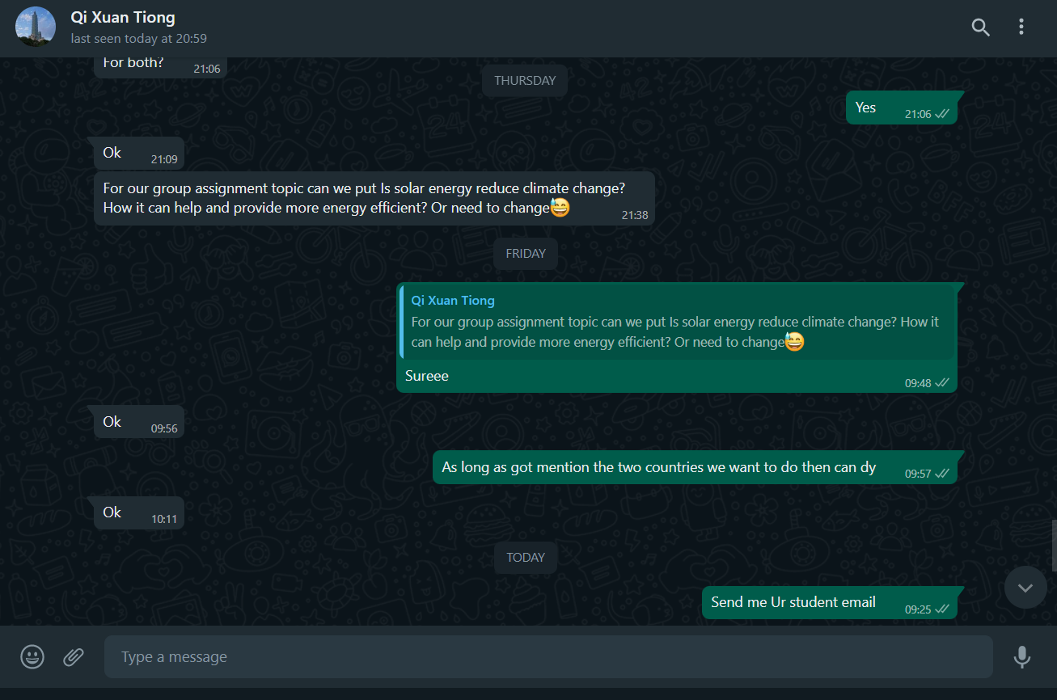
Communication Channel (Whatsapp)

Slide 5
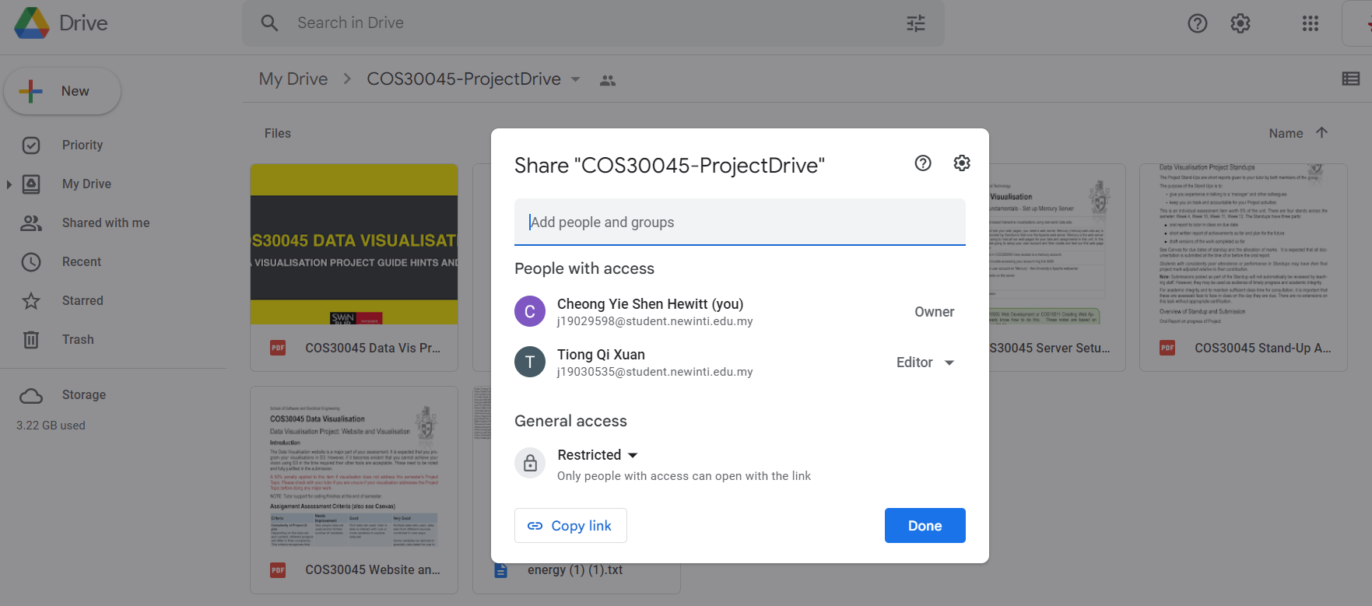
Shared Drive/Documentation (Google Drive)

